Slide 1
STOCK PRICE PREDICTOR
Team: Hoang Dao
Advisor: Fred Annexstein; Ali Minai

Slide 2
Project Goal
Because stock trading is a fairly complex and advanced fields in both finance and technology aspects, this application seeks to narrow that gap and make it easier for people to get into.
This project uses a special kind of recurrent neural network (RNN) called Long-Short Term Memory Networks that takes in previous stock closing prices and trading volume as inputs and visualizes the values over time to helps users predict whichever stock that yields the most profit.

Slide 3
Project Abstract
Financial companies, large hedge funds and professionals who are invested in stock trading have long been using financial models to learn about the market behavior and make profitable investments and trades. Trying to predict the stock market by using different forecasting techniques to predict future stock values based on past returns is an interesting challenge which has attracted much of data scientists' attention recently. For me, there has always been this question if we can actually predict stock prices with machine learning? Stock Price Predictor is the project on technical analysis, visualization and prediction using stock datasets from multiple sources provided by Google Finance. This project aims to utilize Deep Learning models, Long-Short Term Memory (LSTM) machine learning algorithm to estimate stock prices the following day. The models and neural network will be incorporated in an iOS app that users can download and use on their mobile devices at any given time.

Slide 4
User Stories
As a college student who learns about the major related to Finance, I want to know how the stock market grows each day so that I would understand how to manage my future move based on the collected results.
As a professional investor, I want to know when, where and which stock to invest so that I could earn profits and not make any loss.
As a college graduate who just starts a job, I want to participate actively in the stock market and need to know when the stock's status changes so that I could earn extra income on the side with my full-time job.
As a retiree, I want to keep myself busy by joining the trading market and need reminders that inform me the right time to invest so that I could grow my saving.
As an unemployed person, I want to find the right stock resource to invest so that I could have a solid income.

Slide 5
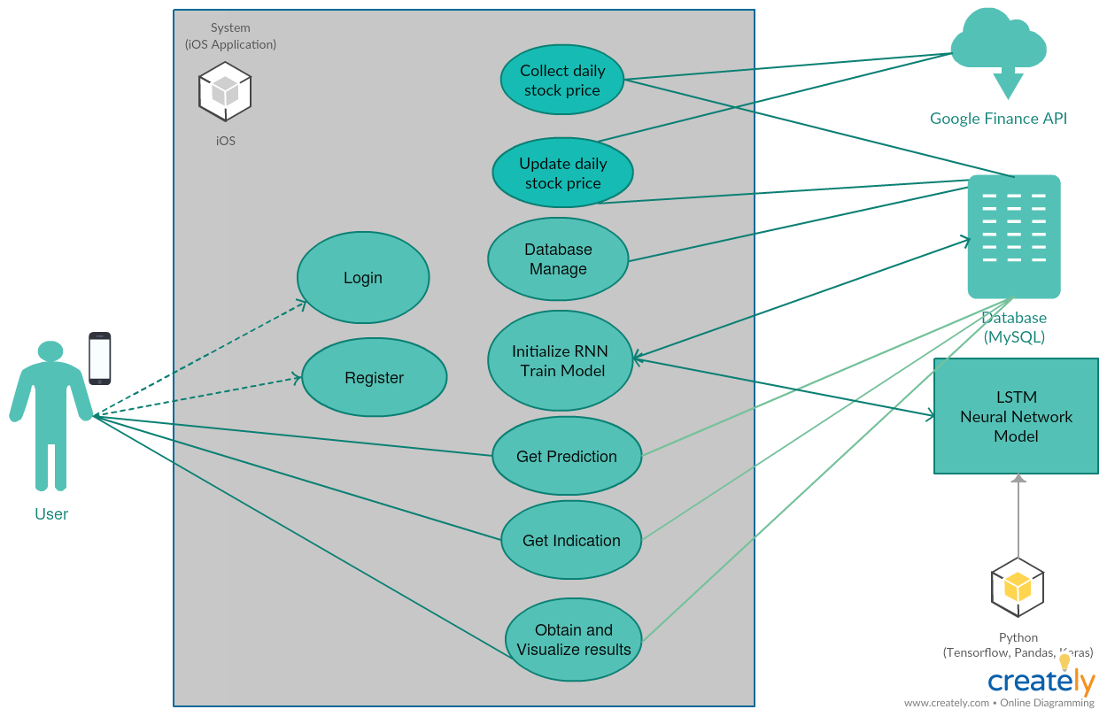
Design Diagrams

Slide 6
Project Progress
Set up the infrastructure and organized the project under a git repository.
Met and discussed with project advisors about the project’s requirements and architecture.
Constructed project timelines and expectations.
Researched knowledge on Machine Learning, Stock APIs and Python libraries to use (Tensorflow, Pandas, Numpy, Keras).

Slide 7
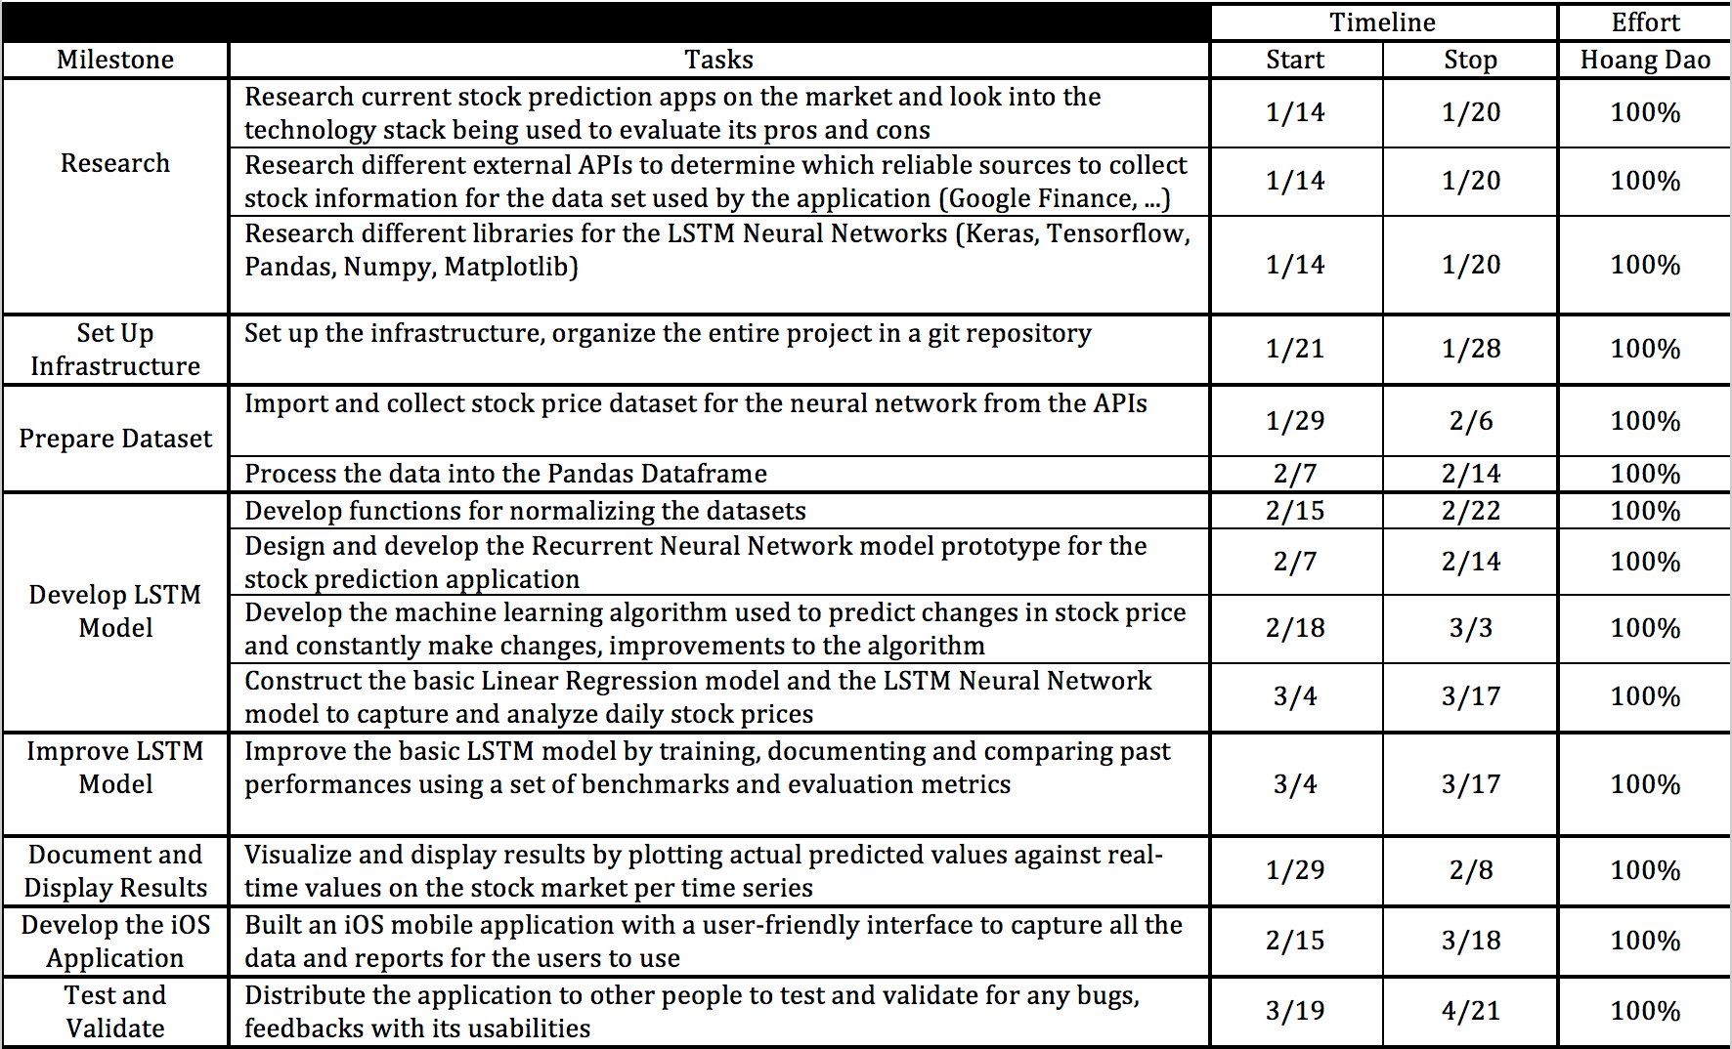
Milestones and Timeline

Slide 8
Thank You

